Slide 1
Networking in the Cloud

Slide 2
"Introducing Cisco Packet Tracer

Slide 3
About Cisco Packet Tracer
Packet Tracer is a cross-platform visual simulation tool designed by Cisco Systems that allows users to create network topologies and imitate modern computer networks. The software allows users to simulate the configuration of Cisco routers and switches using a simulated command line interface. Packet Tracer makes use of a drag and drop user interface, allowing users to add and remove simulated network devices as they see fit. The software is mainly focused towards Cisco Networking Academy students as an educational tool for helping them learn fundamental CCNA concepts. Previously students enrolled in a CCNA Academy program could freely download and use the tool free of charge for educational use. Packet Tracer allows users to create simulated network topologies by dragging and dropping routers, switches and various other types of network devices. A physical connection between devices is represented by a 'cable' item. Packet Tracer supports an array of simulated Application Layer protocols, as well as basic routing with RIP, OSPF, EIGRP, BGP, to the extents required by the current CCNA curriculum.

Slide 4
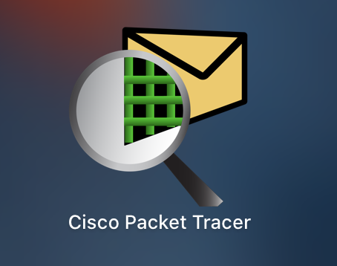
How to Install Cisco Packet Tracer on Windows?
Packet Tracer is computer software that is designed with the purpose of making network simulations to understand the networking and cyber security concepts in an easy way. It is built by Cisco Corporation and is available for free for different operating systems like macOS, Windows, Linux, etc. It is easy to easy with a simple interface.

Slide 5

Installing Packet Tracer on Windows
Follow the below steps to install Packet Tracer on Windows:
Step 1: Visit the official website of Netacad using any web browser.
Step 2: Press the login button and select log In option.
Step 3: Next screen will appear, click on the sign-up option.
Step 4: Next screen will appear and will ask for email and password and other simple details, fill them and click on Register.

Slide 6
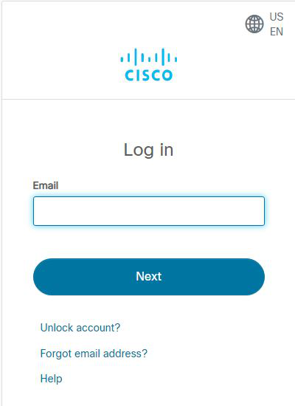
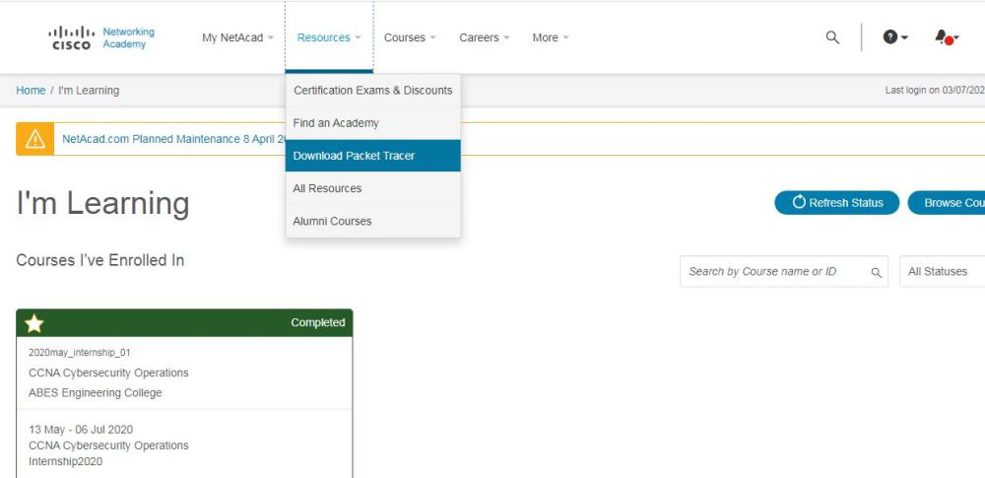
Step 5: Now the login screen appears again so fill in the Email id.
Step 6: On the next screen enter the password and press the Login button.
Step 7: Dashboard will initialize, now click on Resources and choose Download Packet Tracer Option.

Slide 7
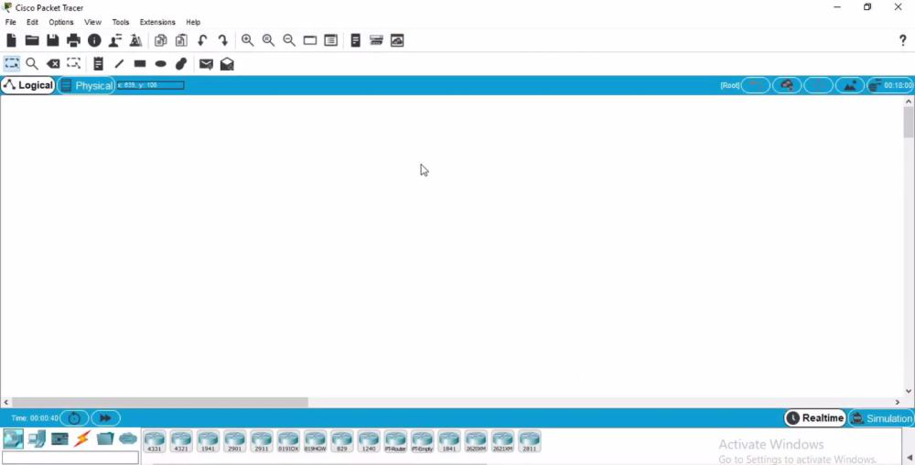
Step 8: On the next web page choose the operating system to download the packet tracer. Downloading will start automatically.
Step 9: Check for the executable file in your system and run it.
Step 10: The installation process will start and will hardly take a minute.
Step 11: An icon is created on the desktop so run it.
Step 12: Interface is initialized and the software is ready to use.

Slide 8
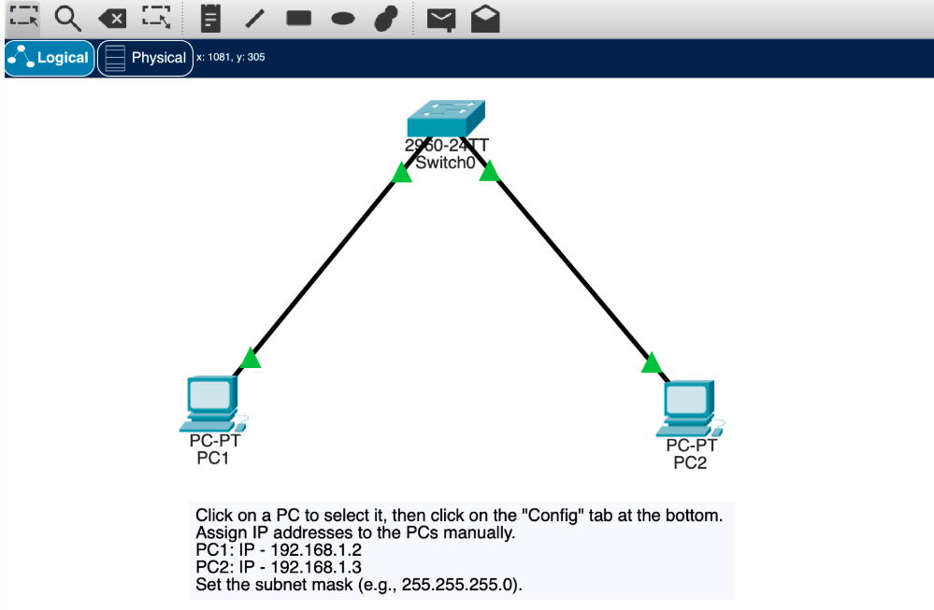
Building a LAN network in Cisco packet tracer

Slide 9
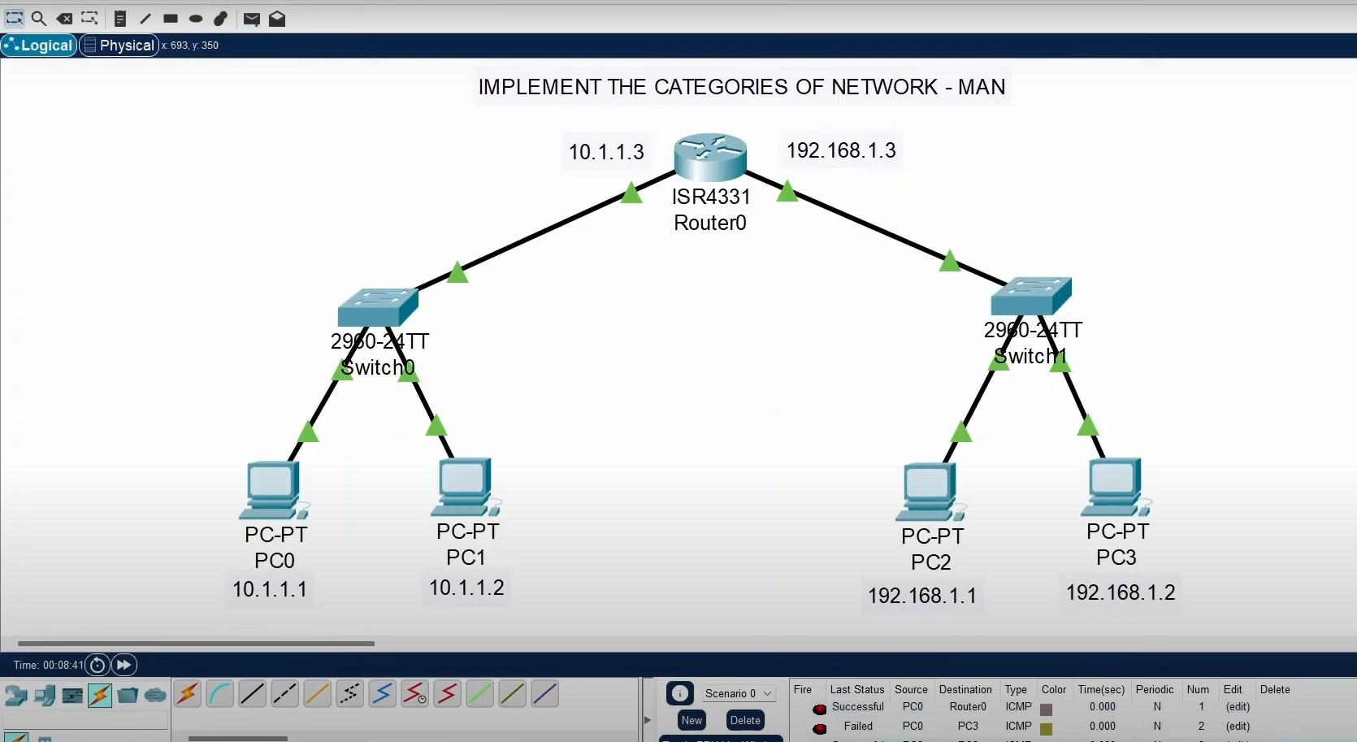
Building a MAN network in Cisco packet tracer

Slide 10
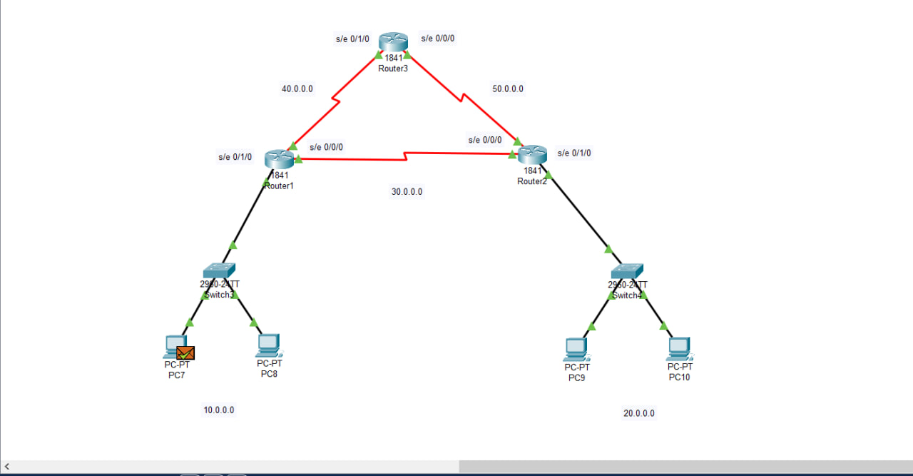
Building a WAN network in Cisco packet tracer

Slide 11
Thank you!

